Slide 1
Bug and bug life cycle

Slide 2
Bug
When the expected and actual behavior is not matching, a Bug may be reported.
It is a programmer's fault where a programmer intended to implement a certain behavior,
but the code fails to correctly conform to this behavior because of incorrect implementation in coding.
It is also known as Defect.

Slide 3
A Bug's Life Cycle
When a bug is first found by a software tester, a report is logged and assigned to a programmer to be fixed. This state is called the open state.
Once the programmer fixes the code, he assigns the report back to the tester and the bug enters the resolved state.
The tester then performs a verification test to confirm that the bug is indeed fixed and, if it is, closes the report.
The bug then enters its final state, the closed state.

Slide 4
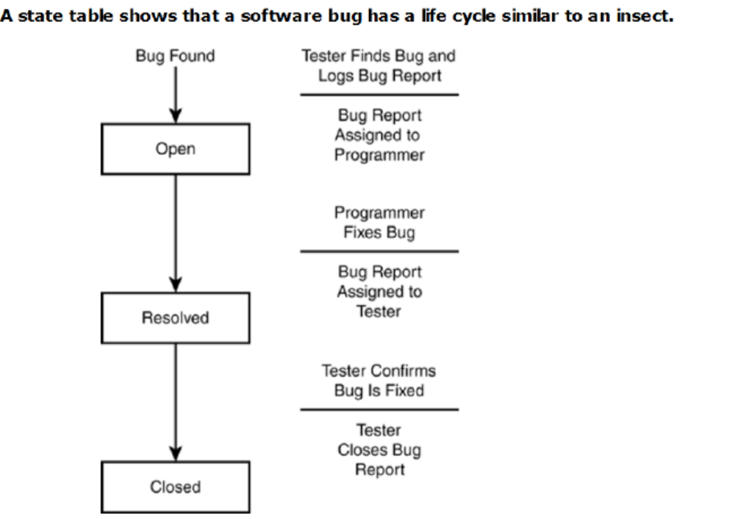

Slide 5
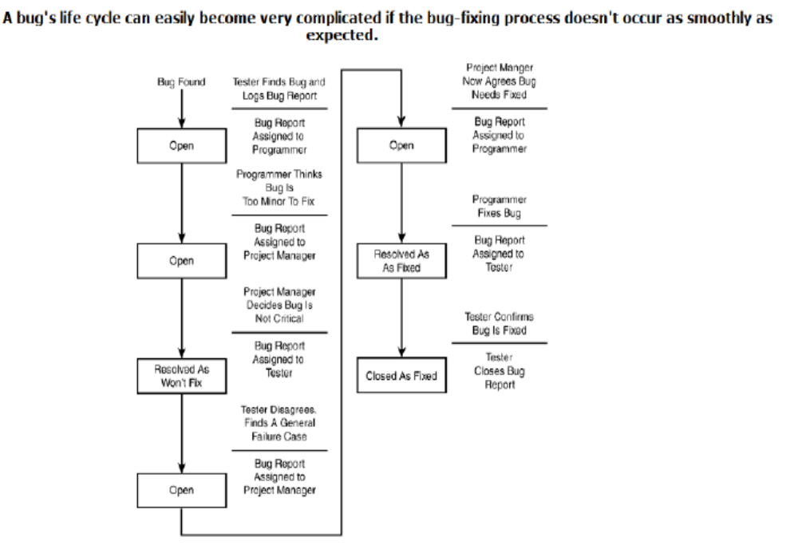

Slide 6
This generic life cycle has two additional states and extra connecting lines.
The review state is where the project manager or the committee, sometimes called a Change Control Board, decides whether the bug should be fixed.
In some projects all bugs go through the review state before they're assigned to the programmer for fixing.
In other projects, this may not occur until near the end of the project, or not at all.
The review state can also go directly to the closed state.
This happens if the review decides that the bug shouldn't be fixed it could be too minor, is really not a problem, or is a testing error.
The other added state is deferred.
The review may determine that the bug should be considered for fixing at some time in the future, but not for this release of the software.

Slide 7
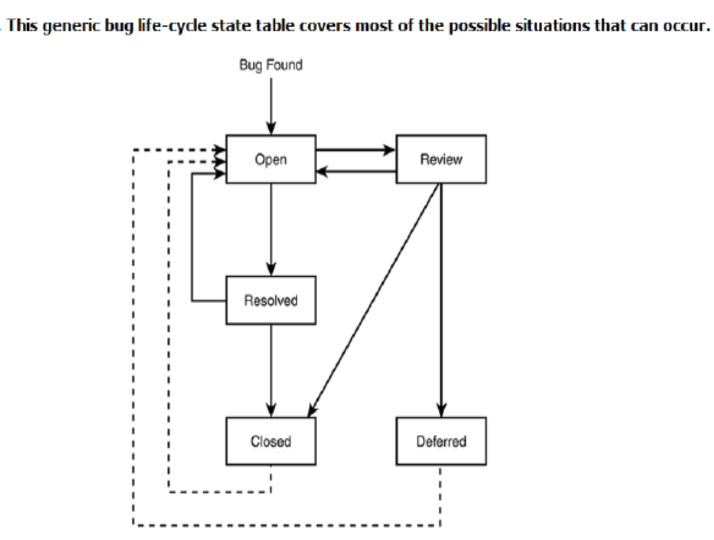

Slide 8
Defect logging and tracking
A large software may have thousands of defects, found by many different people
Often person who fixes (usually the coder) is different from who finds
Due to large scope, reporting and fixing of defects cannot be done informally
Defects found are usually logged in a defect tracking system and then tracked to closure
Defect logging and tracking is one of the best practices in industry
Testing

Slide 9
Defect logging…
A defect in a software project has a life cycle of its own, like
  Found by someone, sometime and logged along with info about it (submitted)
  Job of fixing is assigned; person debugs and then fixes (fixed)
  The manager or the submitter verifies that the defect is indeed fixed (closed)
More elaborate life cycles possible
Testing

Slide 10
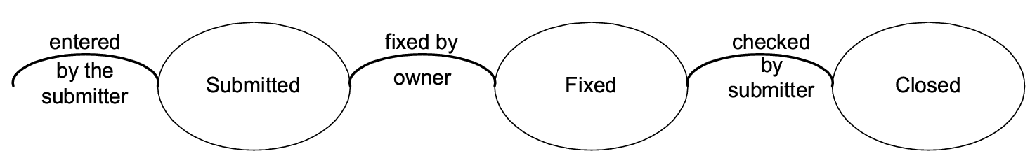
Defect logging…
Testing

Slide 11
Defect logging…
During the life cycle, info about defect is logged at diff stages to help debug as well as analysis
Defects generally categorized into a few types, and type of defects is recorded
  ODC is one classification
  Some std categories: Logic, standards, UI, interface, performance, documentation,..
Testing

Slide 12
Defect logging…
Severity of defects in terms of its impact on sw is also recorded
Severity useful for prioritization of fixing
One categorization
  Critical: Show stopper
  Major: Has a large impact
  Minor: An isolated defect
  Cosmetic: No impact on functionality
Testing

Slide 13
Defect logging and tracking…
Ideally, all defects should be closed
Sometimes, organizations release software with known defects (hopefully of lower severity only)
Organizations have standards for when a product may be released
Defect log may be used to track the trend of how defect arrival and fixing is happening
Testing

